Slide 1


IMAGE DESCRIPTION
GEN AI
MADE BY:
MUHAMMAD HUMAM - 210201080
RAFAY QURESHI - 210201035

Slide 2

CONTENT
01
INTRODUCTION
02
OUTPUT
03
DATASETS
04
MODEL
05
LEARNING OUTCOMES
06
PROBLEMS
07
FUTURE

Slide 3
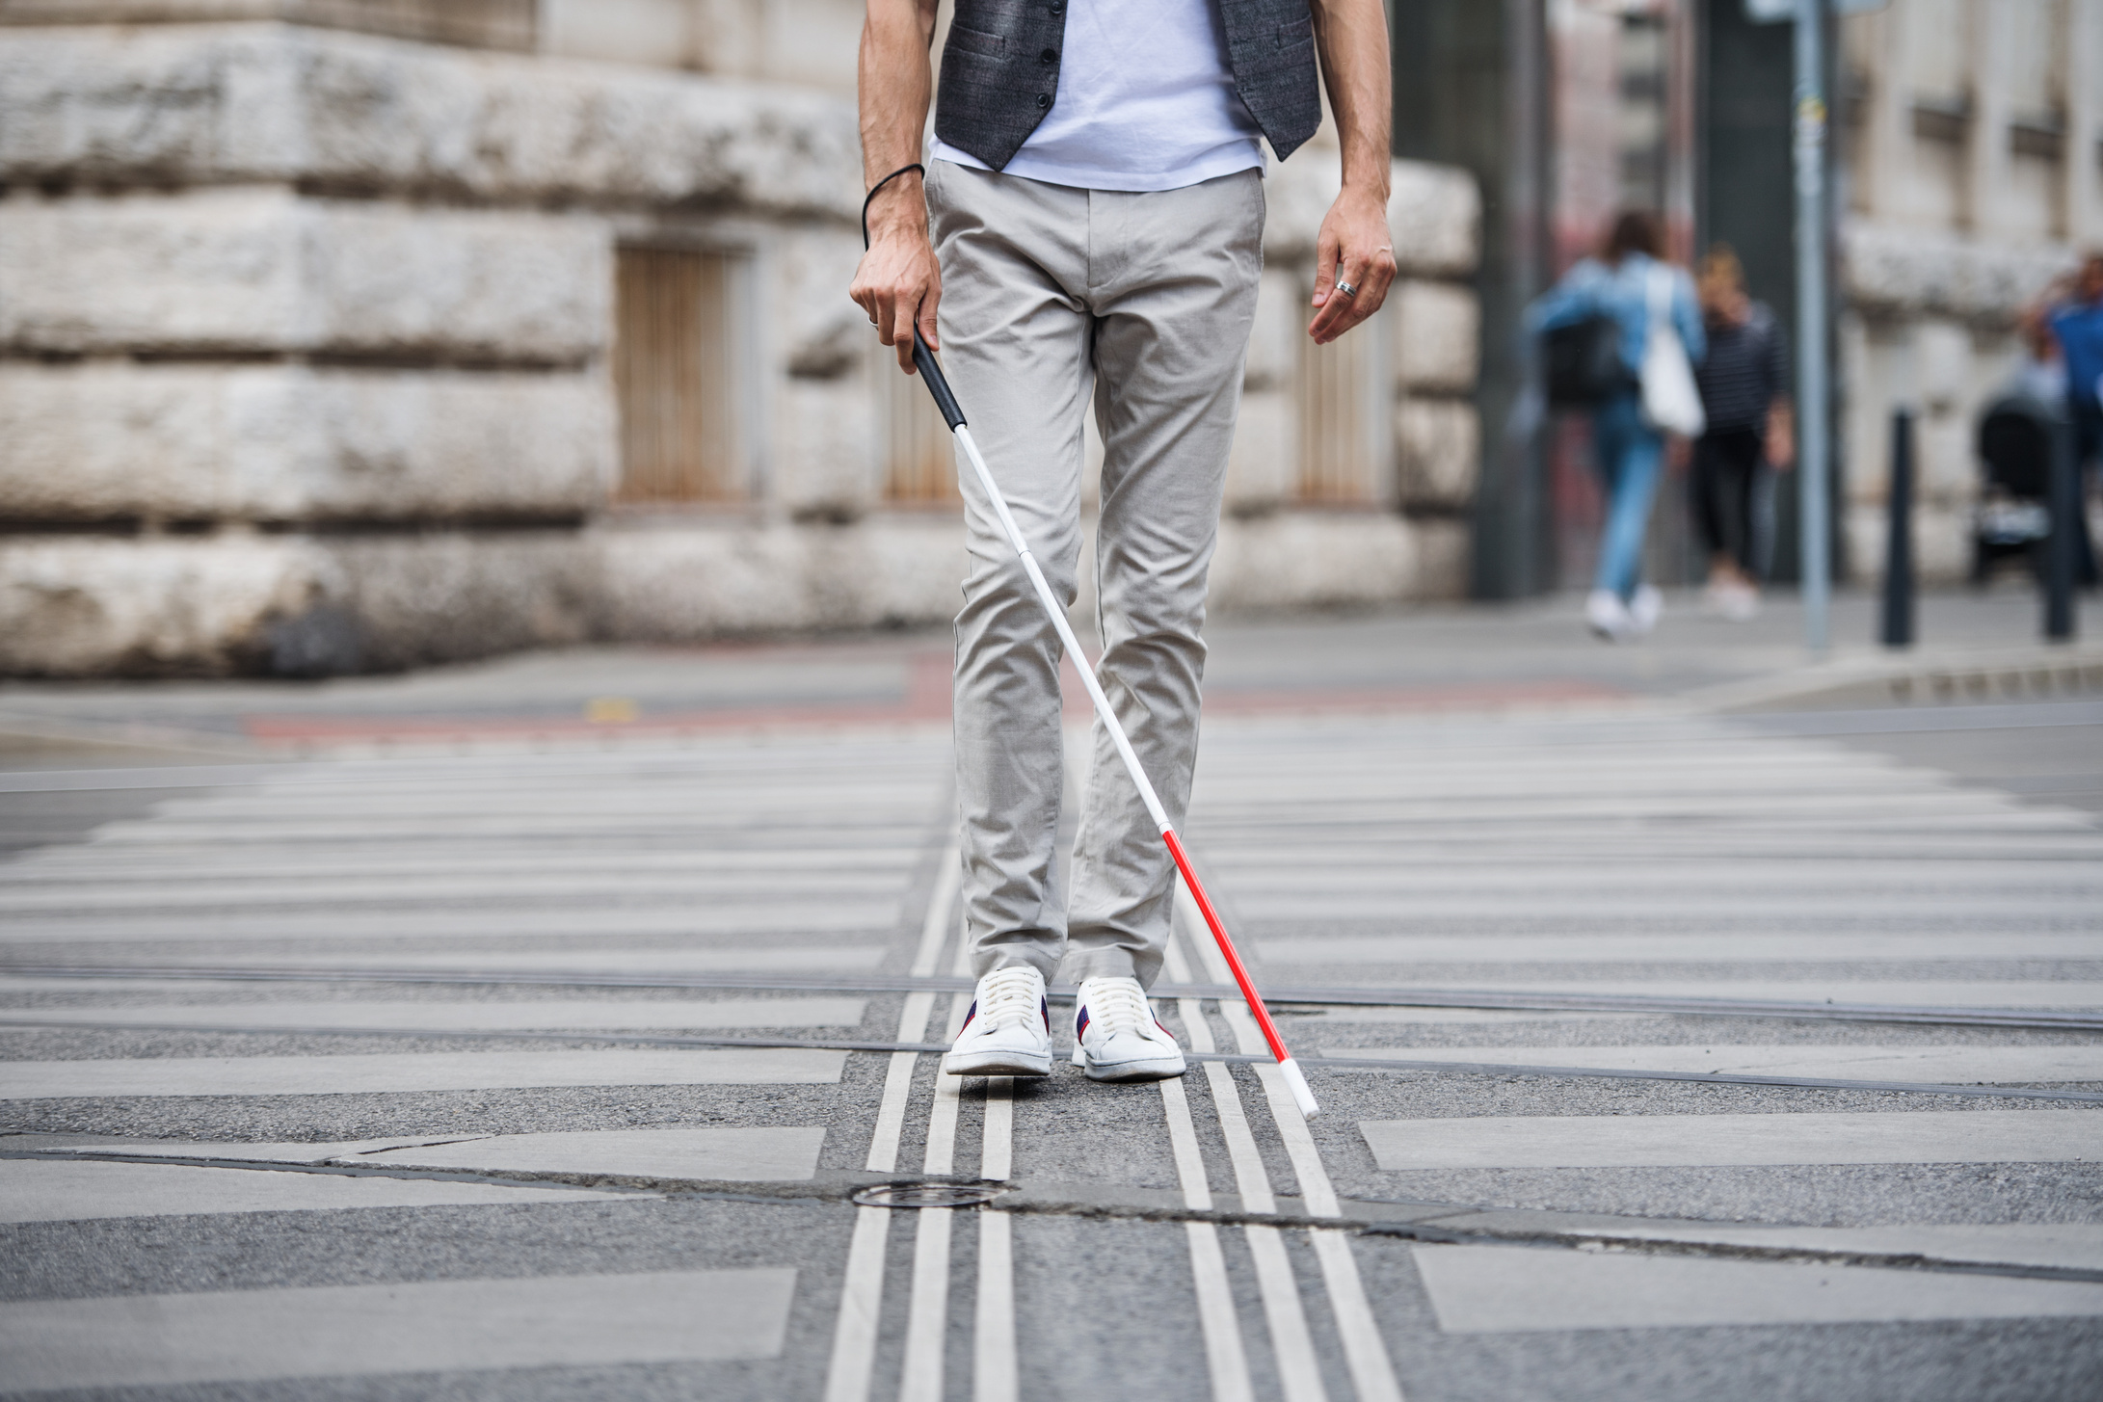

INTRODUCTION
Enabling visually impaired people to perceive the world around them and understand a little bit of beauty of the world
image description models that can generate detailed captions capturing not just objects, but also attributes, relationships, activities, and overall scene context.

Slide 4

OUTPUTS
At current stage the model may not be able to give a complete output, reason stated later on.

Slide 5
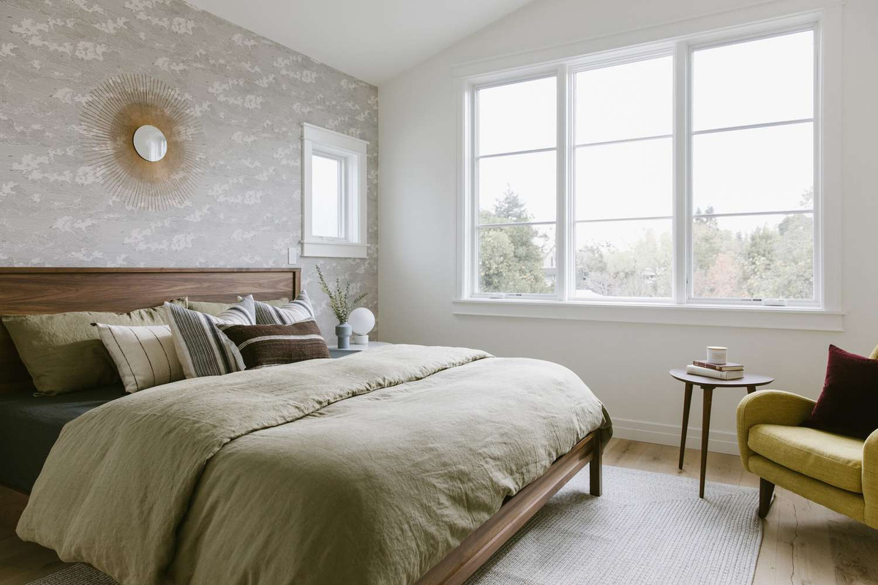
IMAGE
PREDICTION
This is a bedroom with a bed. The bed has a white comforter and a white bedspread. There is a large mirror above.

Slide 6
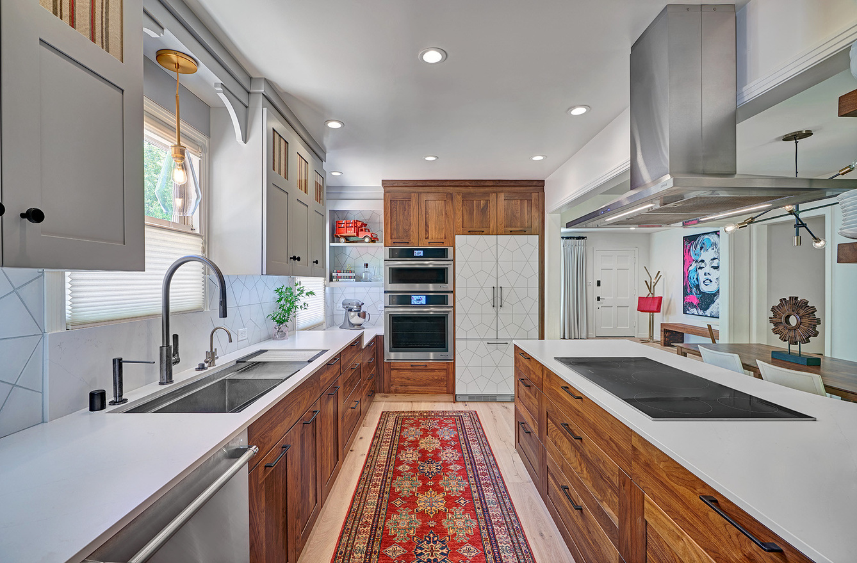
IMAGE
PREDICTION
This is a kitchen with a white stove, the cabinets are dark brown color. there is a white stove with a white stove and a ...

Slide 7

DATASETS
FLICKER30K
IIW
VISUAL GENOME
ADE30K
MS COCO

Slide 8

MODELS
Total of 20 architectures, with each one have 4 to 5 tunings
Resnet 18 - pretrained
ResNet 50 / 101
Transformer
Attention
LSTM
Resnet 50
V8
Attention
V1
GRU
V6

Slide 9
MODELS
Efficientnet-b0
Bert
BiLSTM
Mobilenet_v2
DistilBert
V10
BiLSTM
V11

Slide 10
GRAPHS

Slide 11
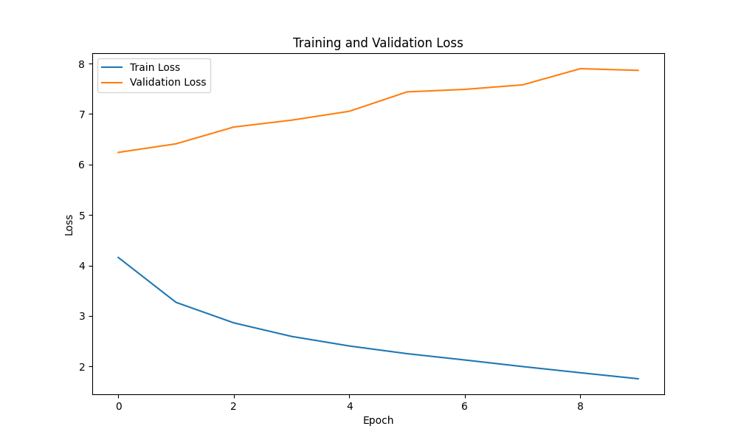
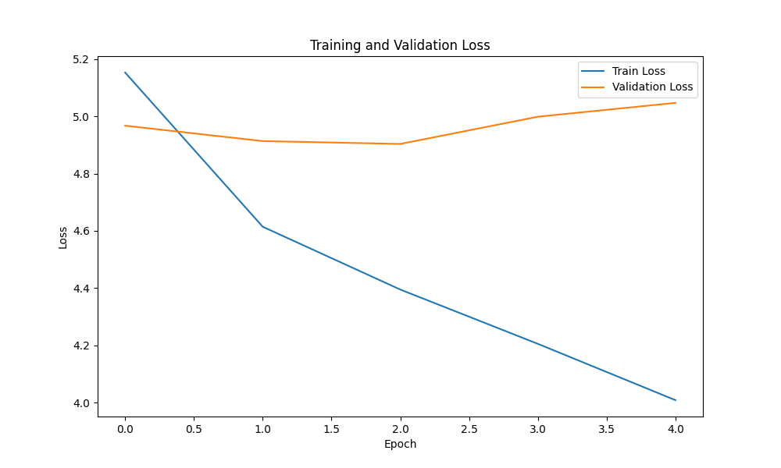
MODEL V6

Slide 12
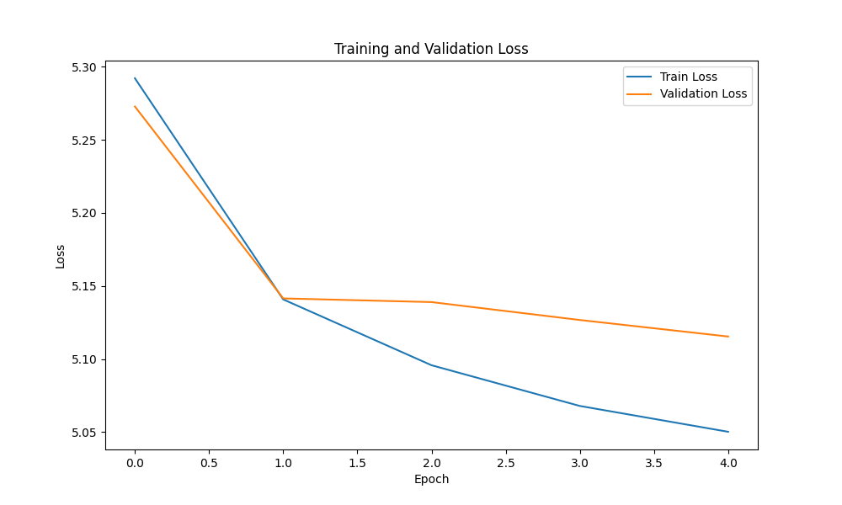
MODEL V8

Slide 13
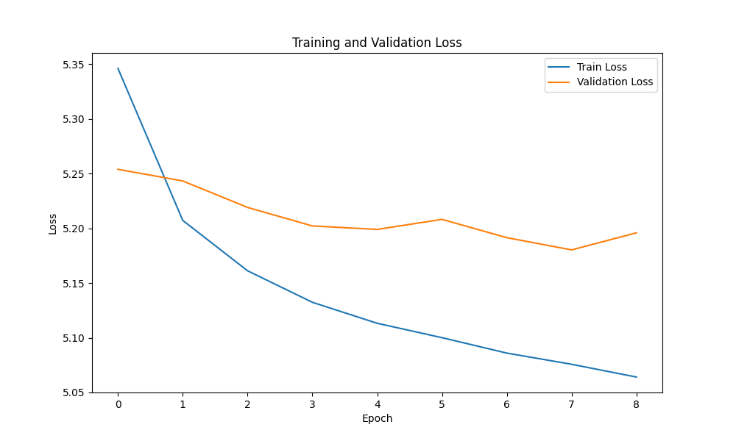
MODEL V8-1

Slide 14
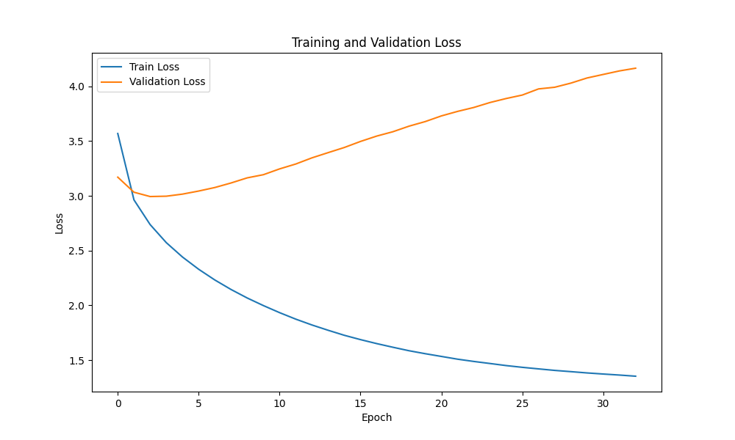
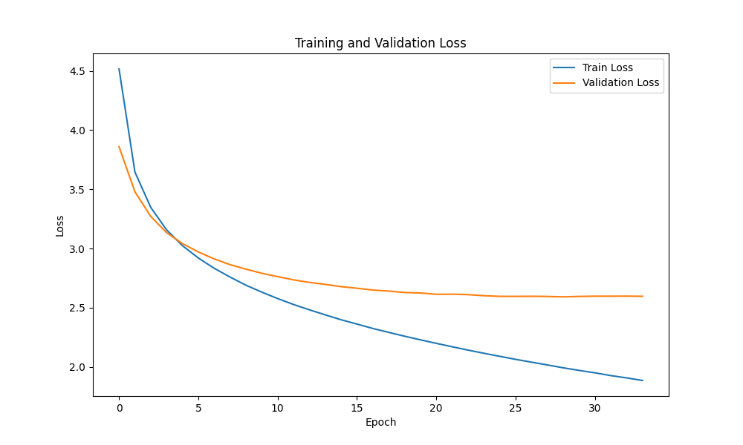
MODEL V10

Slide 15
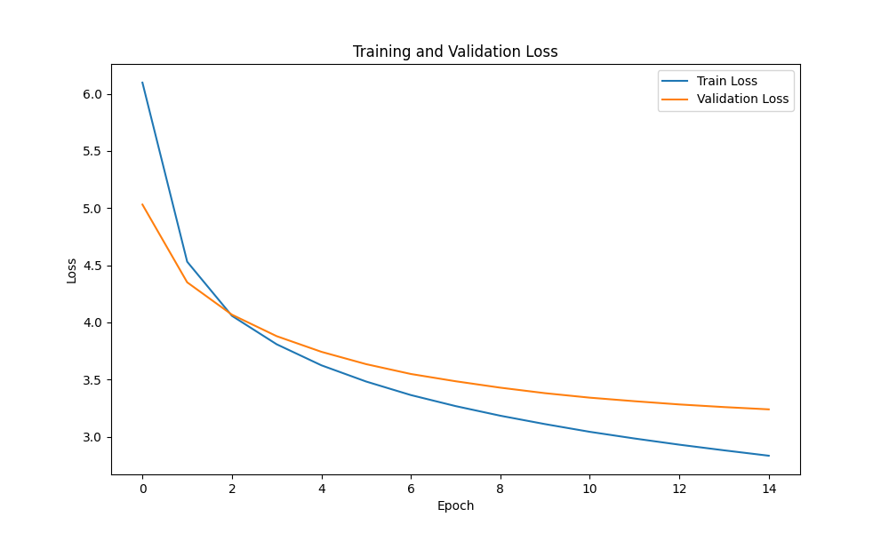
MODEL V11

Slide 16
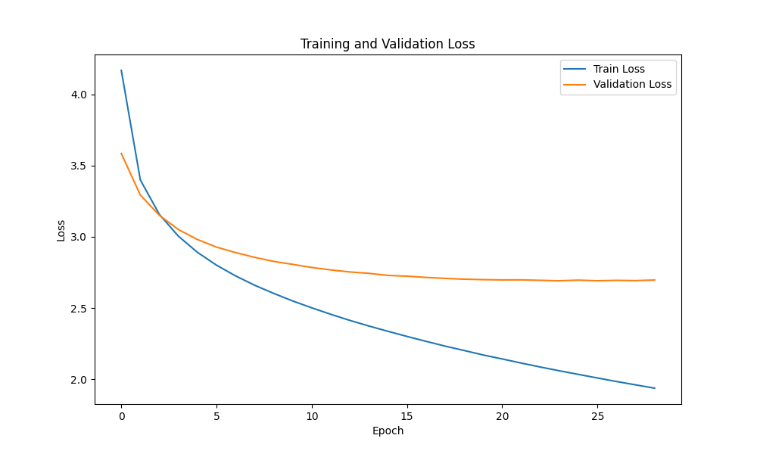
MODEL V11-2

Slide 17
MODEL V11-2

Slide 18
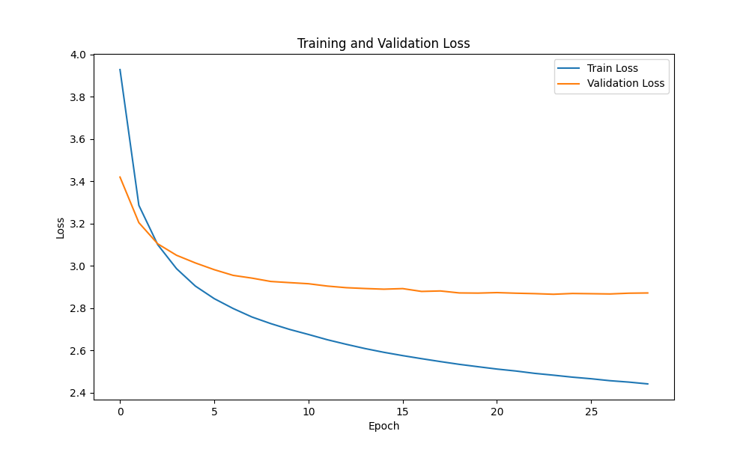
MODEL V11-3 LOSS

Slide 19
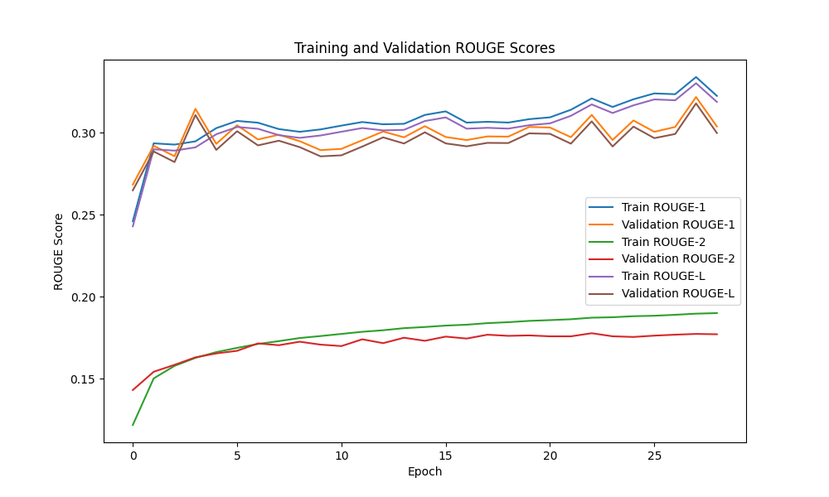
MODEL V11-3 ACCURACY

Slide 20
LEARNING OUTCOME
Architecture
Designing
Patience
Memory Managment

Slide 21
PROBLEM FACED
Training Time
Model tuning
Memory managment
Hardware

Slide 22

FUTURE
This is just a beginning, in future the model will be trained on much larger dataset then this, the model will go under large changes and much more. this model is part of our mobile app that will be used to help visually impaired people

Slide 23
THANK YOU

